Slide 1
Software Requirements Engineering
Lecture 16
Engr. Sara Rehmat

Slide 2
Activity Diagram
A UML activity diagram is a useful way to visually represent the logic flow in a complex use case, as illustrated in the following.
Activity diagrams show the decision points and conditions that cause a branch from the normal flow into an alternative flow.

Slide 3
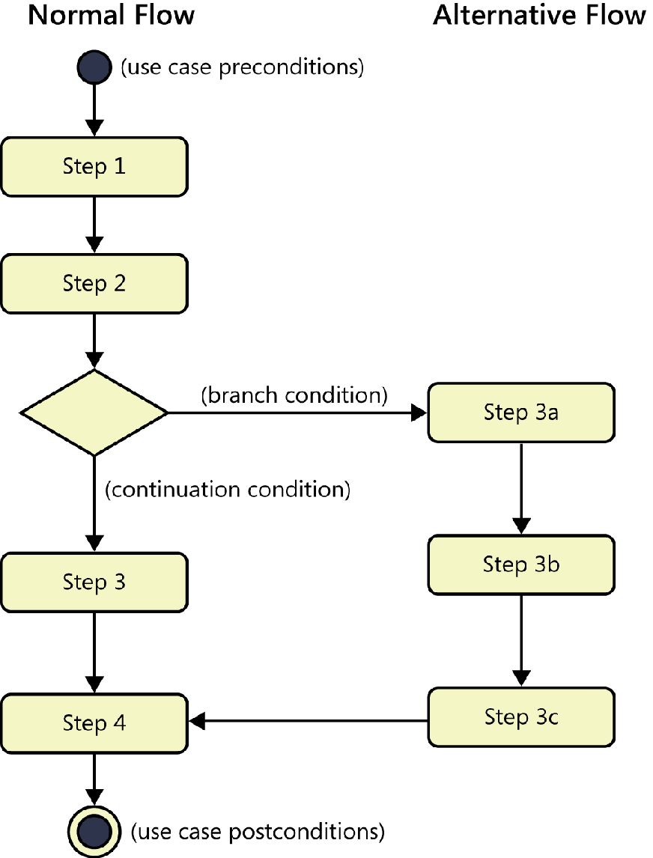
Activity Diagram

Slide 4
Extend and include – Relationships between use cases
You can show two types of relationships, called extend and include, between use cases in a use case diagram.
The normal flow for the “Request a Chemical” use case is to request a chemical from the Chemical Stockroom; an alternative flow is to request a chemical from a vendor
The Buyer has a use case called “Search Vendor Catalogs.” Suppose you wanted to let the Requester execute that same “Search Vendor Catalog” use case as an option when requesting a chemical, as part of the alternative flow processing. A use case diagram can show that a standalone use case like “Search Vendor Catalogs” extends the normal flow into an alternative flow.

Slide 5
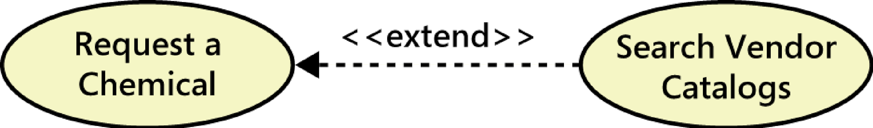
Extend use case

Slide 6
Include relationship
Sometimes several use cases share a common set of steps.
To avoid duplicating these steps in each such use case, you can define a separate use case that contains the shared functionality and indicate that the other use cases include that subordinate use case.
Consider an accounting software package. Two use cases are “Pay a Bill” and “Reconcile Credit Card,” both of which might involve the user writing a check to make the payment. You can create a separate use case called “Write a Check” that contains the common steps involved in writing the check

Slide 7
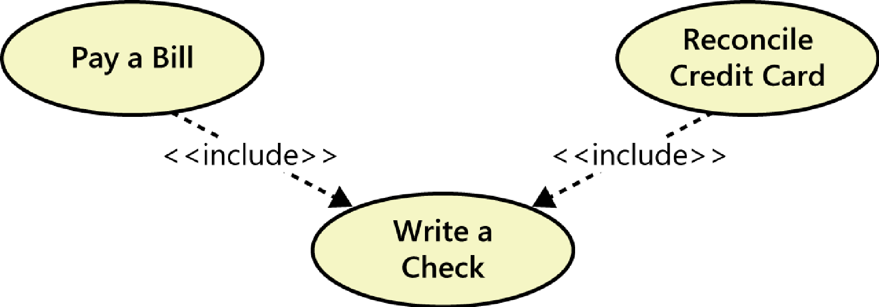
Include use case

Slide 8
Aligning preconditions and postconditions
In many applications, the user can chain together a sequence of use cases into a “macro” use case that describes a larger task.
Some use cases for an e-commerce website might be “Search Catalog,” “Add Item to Shopping Cart,” and “Pay for Items in Shopping Cart.”
If you could perform each of these activities independently, they are individual use cases.
However, you might also be able to perform all three activities in sequence as a single large use case called “Buy Product,” as shown in the following figure. The description of the “Buy Product” use case could simply say to perform each of those other three use cases in turn: “Search Catalog,” “Add Item to Shopping Cart,” and then “Pay for Items in Shopping Cart.”
The postconditions of one use case must satisfy the preconditions of the next one in the sequence.

Slide 9
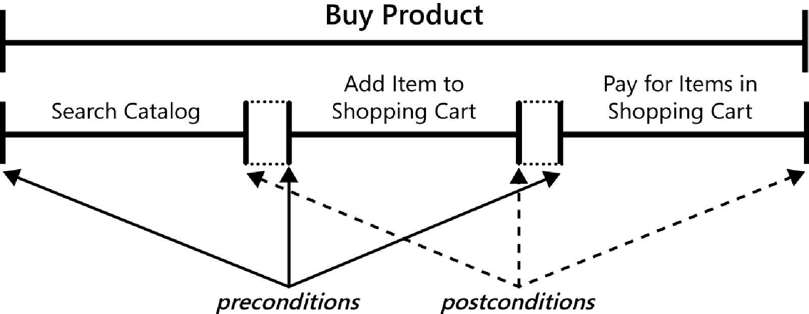
Aligning preconditions and postconditions

Slide 10
Identifying use cases
Identify the actors first, then lay out the business processes being supported by the system, and define the use cases for activities where actors and systems interact.
Create a specific scenario to illustrate each business process, then generalize the scenarios into use cases and identify the actors involved in each one.
Using a business process description, ask, “What tasks must the system perform to complete this process or convert the inputs into outputs?” Those tasks might be use cases.
Identify the external events to which the system must respond, then relate these events to participating actors and specific use cases.
Use a CRUD analysis to identify data entities that require use cases to create, read, update, delete, or otherwise manipulate them
Examine the context diagram and ask, “What objectives do each of these external entities want to achieve with the help of the system?”

Slide 11
Use cases often involve some additional information or requirements that do not fit within any of the template sections. Use the “Other Information” section to record pertinent performance and other quality requirements, constraints, and external interface knowledge.

Slide 12
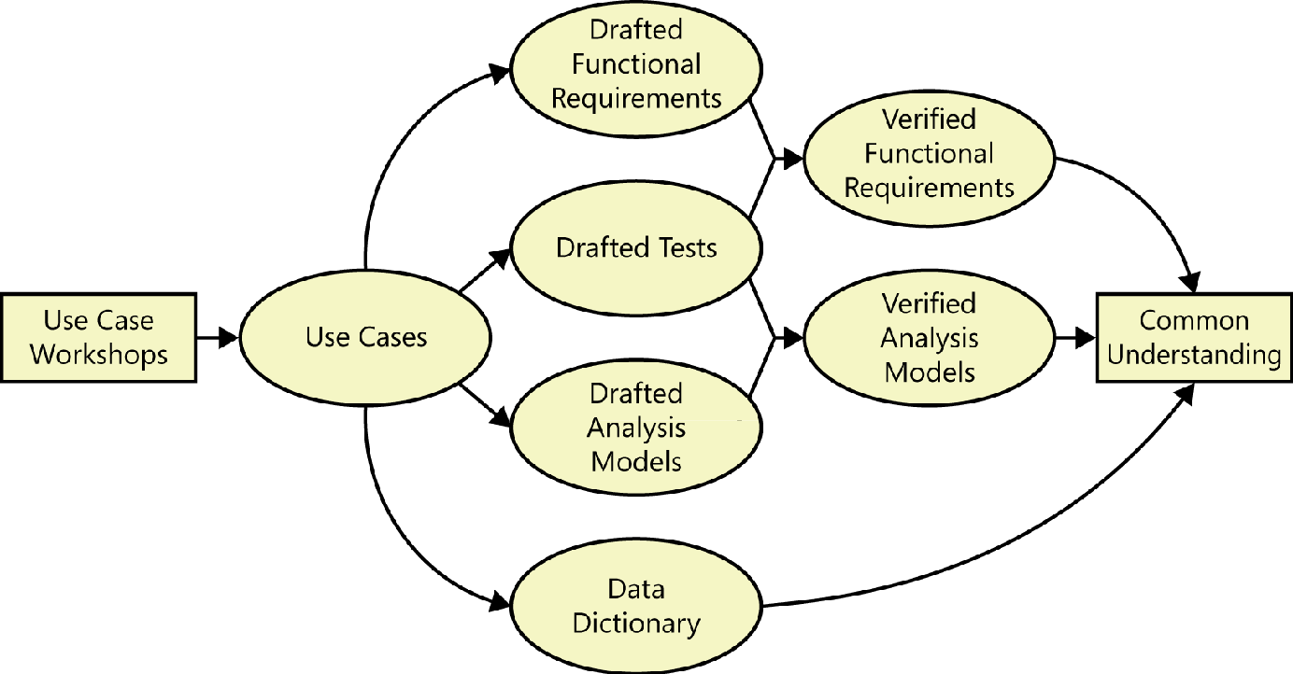
Use case Elicitation work products

Slide 13
Use cases and functional requirements
Software developers don’t implement business requirements or user requirements.
They implement functional requirements, specific bits of system behavior.
The user requirements don’t contain all the information that a developer needs to write the software.
E.g. The user of an ATM doesn’t know about any back-end processing involved, such as communicating with the bank’s computer.
To reduce this uncertainty, consider having a BA explicitly specify the functional requirements necessary to implement each use case.
You can document the functionality associated with a use case in several ways.

Slide 14
a. Use cases only
One possibility is to include the functional requirements along with each use case specification, if they aren’t already evident.
You’ll still need to document non-functional requirements and any functionality that’s not associated with a use case.
Additionally, several use cases might need the same functional requirement. Rather than duplicate them, cross-reference functional requirements that appear in multiple use cases.

Slide 15
b. Use cases and functional requirements
Another option is to write fairly simple use cases and document the functional requirements derived from each one in an SRS or a requirements repository. In this approach, you should establish traceability between the use cases and their associated functional requirements. That way, if a use case changes, you can quickly find the affected functional requirements. The best way to manage the traceability is with a requirements management tool.

Slide 16
c. Functional requirements only
One more option is to organize your functional requirements by use case or by feature, and include both the use cases and the functional requirements in the SRS or requirements repository.
Most of the use cases can be written in very concise form, not completing the full template. The details can then be specified through a set of functional requirements. This approach doesn’t result in a separate user requirements document.

Slide 17
d. Use cases and tests
If you write both detailed use case specifications and functional requirements, you might notice some duplication, particularly around the normal flow. There is little value in writing the same requirement twice. So another strategy is to write fairly complete use case specifications, but then write acceptance tests to determine if the system properly handles the basic behavior of the use case, alternative success paths, and the various things that could go wrong.

Slide 18
Use case traps to avoid
Too many use cases
Highly complex use cases
Including design in the use cases
Including data definitions in the use cases
Use cases that users don’t understand

